Slide 1
ADO.NET - Lesson 03
The SqlCommand Object
Training time: 15 minutes
Author: CuongNV3

Slide 2
Objectives
Know what a command object is.
Learn how to use the ExecuteReader method to query data.
Learn how to use the ExecuteNonQuery method to insert and delete data.
Learn how to use the ExecuteScalar method to return a single value.

Slide 3
Introduction
A SqlCommand object allows you to specify what type of interaction you want to perform with a database.
The SqlCommand object can be used to support disconnected data management scenarios, but in this lesson we will only use the SqlCommand object alone.
A later lesson on the SqlDataAdapter will explain how to implement an application that uses disconnected data.

Slide 4
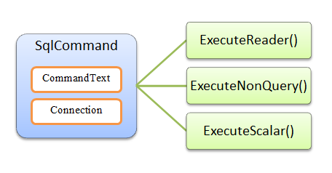
Introduction (2)

Slide 5
Creating a SqlCommand Object
Constructors
Name | Description
SqlCommand | Initializes a new instance of the SqlCommand class.
SqlCommand(String) | Initializes a new instance of the SqlCommand class with the text of the query.
SqlCommand(String, SqlConnection) | Initializes a new instance of the SqlCommand class with the text of the query and a SqlConnection.
SqlCommand(String, SqlConnection, SqlTransaction) | Initializes a new instance of the SqlCommand class with the text of the query, a SqlConnection, and the SqlTransaction.
Example:
SqlCommand command = new SqlCommand(selectFromCustomers, connection);

Slide 6
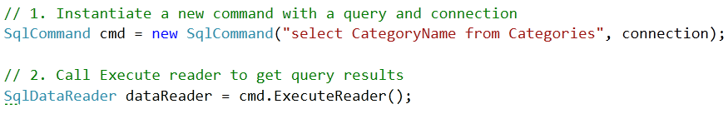
Querying Data
When using a SQL select command, you retrieve a data set for viewing. To accomplish this with a SqlCommand object, you would use the ExecuteReader method, which returns a SqlDataReader object.
The example below shows how to use the SqlCommand object to obtain a SqlDataReader object:

Slide 7
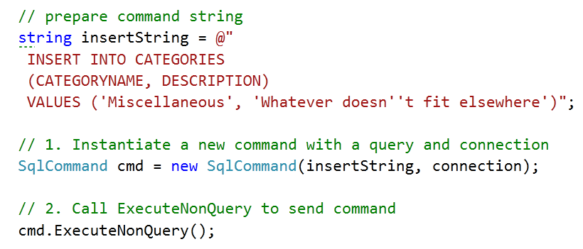
Inserting Data
To insert data into a database, use the ExecuteNonQuery method of the SqlCommand object.
The following code shows how to insert data into a database table:

Slide 8
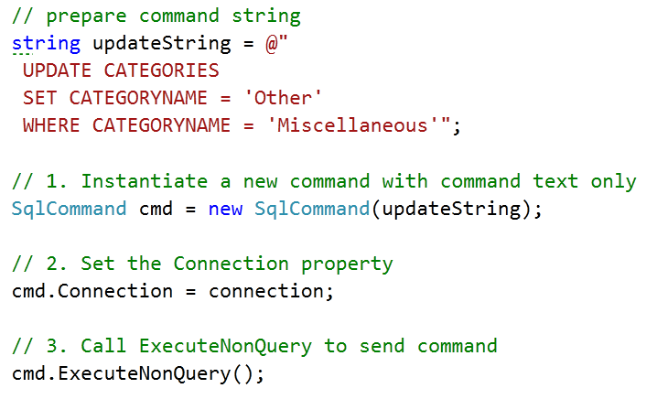
Updating Data
The ExecuteNonQuery method is also used for updating data.
The following code shows how to update data:

Slide 9
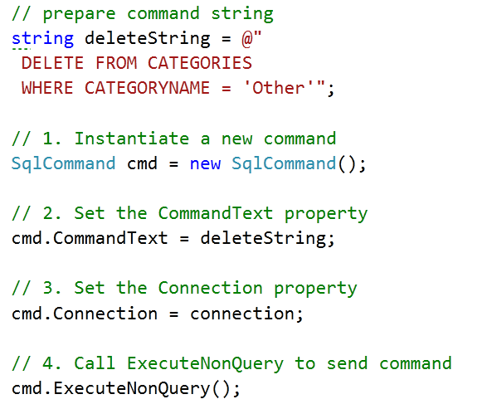
Deleting Data
You can also delete data using the ExecuteNonQuery method.
The following example shows how to delete a record from a database:

Slide 10
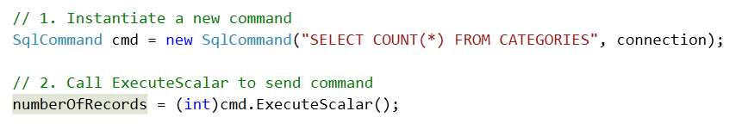
Getting Single values
Sometimes all you need from a database is a single value, which could be a count, sum, average, or other aggregated value from a data set. Performing an ExecuteReader and calculating the result in your code is not the most efficient way to do this. The best choice is to let the database perform the work and return just the single value you need.
The following example shows how to do this with the ExecuteScalar method:

Slide 11
Using SqlCommand
Querying Data
Inserting Data
Updating Data
Deleting Data
Getting Single values
Demo

Slide 12
Summary
A SqlCommand object allows you to query and send commands to a database.
It has methods that are specialized for different commands:
  The ExecuteReader method returns a SqlDataReader object for viewing the results of a select query.
  For insert, update, and delete SQL commands, you use the ExecuteNonQuery method.
  If you only need a single aggregate value from a query, the ExecuteScalar is the best choice.

Slide 13
Q&A
Thanks!

